Slide 1
Separation procedures

Slide 2
Introduction to Separation

Slide 3
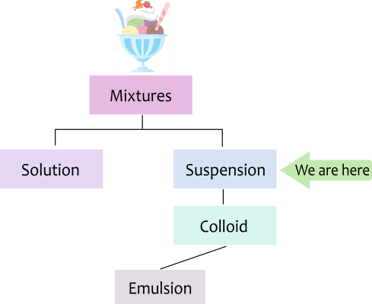
By the end of this lesson you should be able to:
1. | List examples of mixtures and separation techniques that are used in everyday life.
2. | Describe the methods used to decant and strain substances.
3. | Compare decanting and straining.

Slide 4
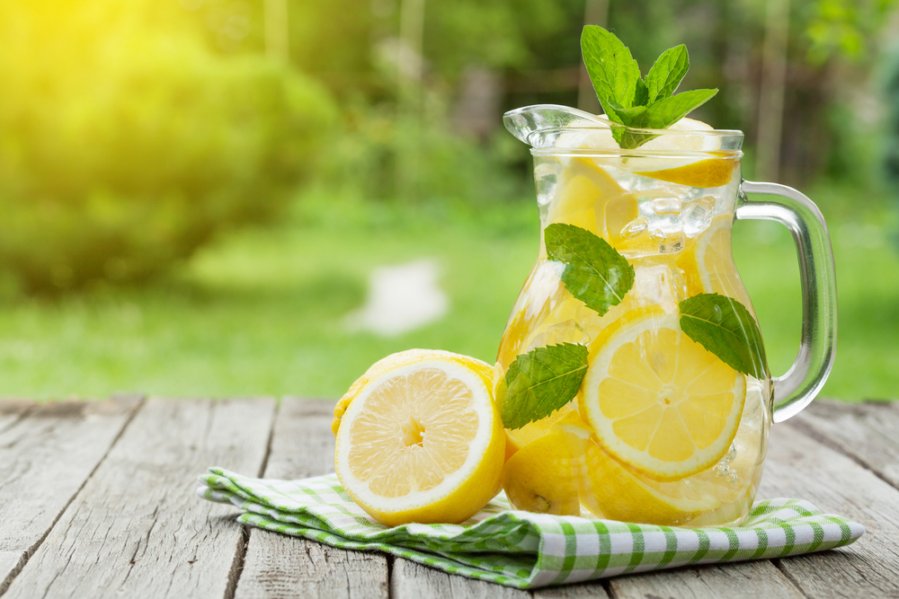
The following lessons look at different ways to separate mixtures.
It is important that you know what the different types of mixtures are.

Slide 5
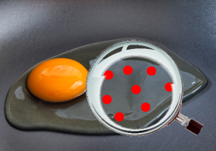
Mixtures, both natural and man-made, surround us in our daily lives.
Our food, drinks, bodies and more are all made up of lots of different types of small particles.
Some situations call for removing specific types of particle from a mixture. Removing these particles is called "separation".

Slide 6
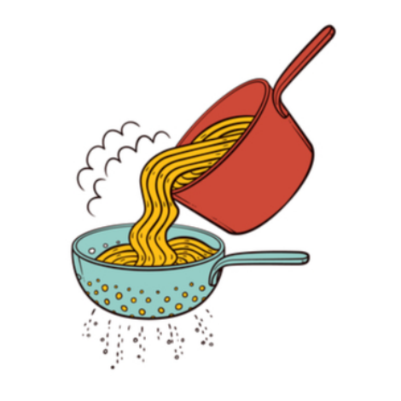
For example, pasta cooking in boiling water is a suspension.
To get the cooked pasta out, you need to separate the suspension into pasta and water.
To do this you use a sieve or drain the water off with the lid.

Slide 7
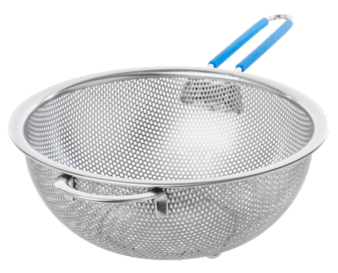
Both of these processes (using a sieve or draining the water) are examples of two different ways to separate mixtures.
They are called sieving and decanting respectively.

Slide 8
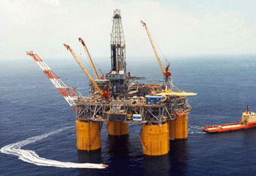
Many industries focus on separating mixtures into their parts.
Crude oil is a mixture of many different chemicals. The oil industry has to use many different techniques to extract the useful chemicals.

Slide 9
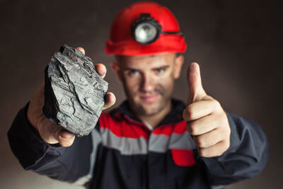
Mining extracts metals from the ground - but most metals are trapped in ores (eg. iron in iron ore) and must be separated to be useful.

Slide 10
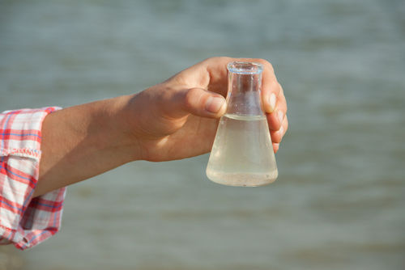
Also, water found in lakes, rivers and oceans is often unable to be consumed and used safely.
We use separation techniques to clean water and make it useful.
Therefore, separation is a very important process to learn about because it has many applications in our lives.

Slide 11
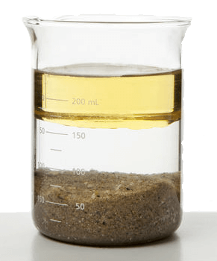
One of the simplest ways to separate a suspension is to let it settle over time.
This is called gravity separation.
Heavier parts of a suspension sink to the bottom, and lighter parts float to the top. This creates layers of separated material. It is now simple to take one part away to be used elsewhere.

Slide 12
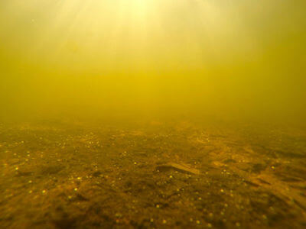
When a suspension contains a solid part that settles to the bottom, we call this sedimentation.
The solid particles that settle are called sediment.
This is what happens in the ocean - suspended dirt, sand, and dead animals settle to the bottom of the sea over time.

Slide 13
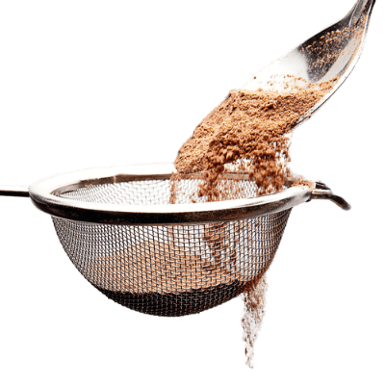
Straining, or sieving, is a separation method that removes liquid through the bottom of the container, leaving the solid behind.
It is used when the solid part of the suspension has large particles.
Containers are designed specifically for this purpose; colanders are used to remove water from food and storm drains are used to remove rubbish from water.

Slide 14

To decant is to remove one part of the suspension.
The easiest parts to remove are the liquids. This can be done by carefully pouring the top layer off. This leaves the rest of the mixture in the container.
However, this method is not very precise.

Slide 15
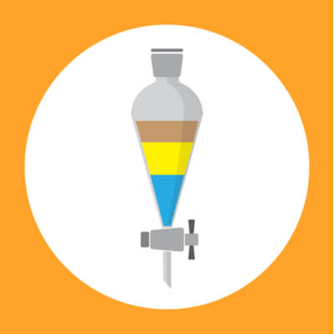
Chemists use a separatory funnel to decant suspensions.
As you can see in the image below, a separatory funnel is a piece of glassware with a tap at the bottom.
Liquids are placed in the funnel and allowed to form layers. The bottom layer can then be removed by opening the tap, and closing it again so that all of the bottom layer is removed.

Slide 16
Filtration

Slide 17
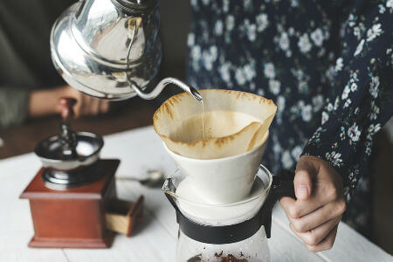
By the end of this lesson you should be able to:
Define the terms filter, filtrate and residue.
Explain how filtration works.

Slide 18
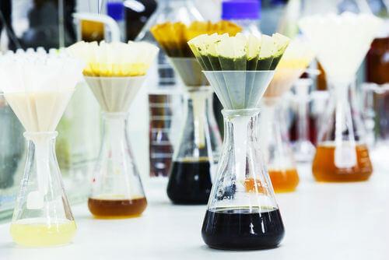
Straining is useful when a suspension contains large solids that you need to separate.
But what if you want to separate out smaller solids?
We use a method called filtration to remove small solids from mixtures.

Slide 19
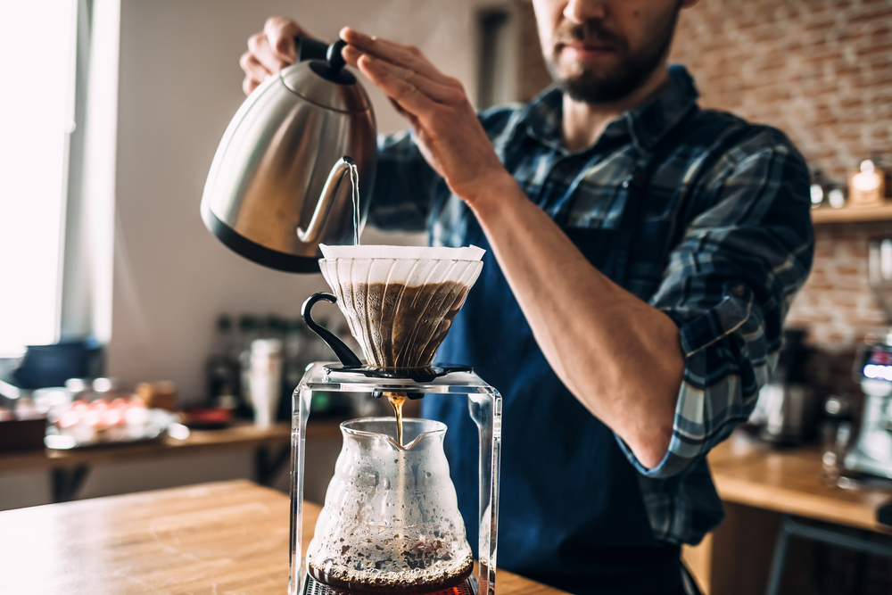
Filtration involves passing a suspension through a filter, which is a material that has lots of very small holes.
The tiny holes allow only some substances to pass through and not others. For example, a coffee filter lets water pass through, but keeps the coffee grounds separate.

Slide 20
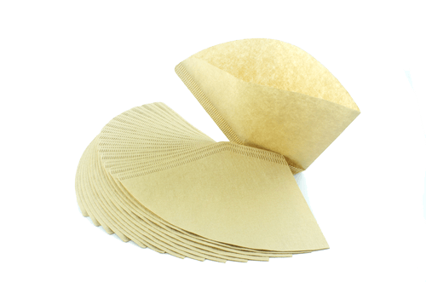
In the lab, we filter using filter paper.
It has tiny holes that let most liquids through, but not solids.

Slide 21
Centrifuging

Slide 22
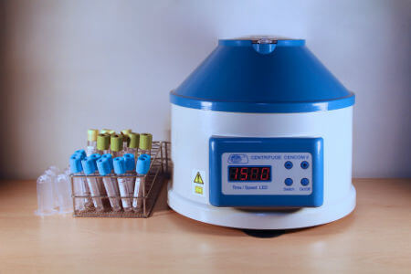
By the end of this lesson you should be able to:
Explain how a centrifuge works.
Recall what substances can be centrifuged.

Slide 23
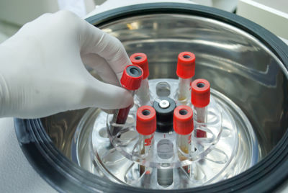
We can use this to separate mixtures.
Heavier, denser things get pushed to the bottom of a container as it spins.
This is called centrifuging. A machine spins suspensions very quickly, sending the solids and heavy liquids to the bottom, creating layers of the different parts of the mixture.

Slide 24
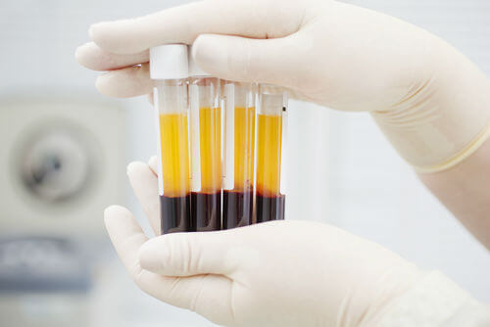
Centrifuging spins a suspension very quickly.
In general, solids will be pushed to the bottom of a centrifuged mixture.
If no solids are present, the heavier or more dense liquid will be the bottom layer.
If blood is centrifuged, the red blood cells are pushed to the bottom leaving the liquid plasma to float on top.

Slide 25
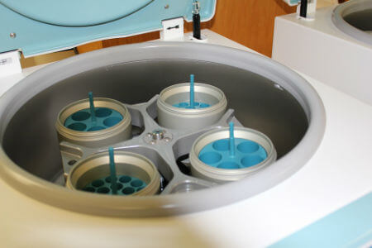
You might be thinking that the same thing can be done by gravity separation, and in most cases this is true.
But there are some suspensions that do not separate over time - like colloids.
The spinning created by centrifuging is able to push the floating particles out of a colloid! This is one of the few ways to separate a colloid.

